Slide 1




Plans for multi-frequency upgrades at OSO 20 m antenna
Dr Miroslav Pantaleev – Onsala Space Observatory
With inputs from:
Dr Christophe Granet - Lyrebird Antenna Research Pty Ltd
Dr John S. Kot - Lyrebird Antenna Research Pty Ltd
Dr Mark Bowen - CSIRO Astronomy and Space Science
Alex Dunnin - CSIRO Astronomy and Space Science

Slide 2
Outline
Motivation, challenges and design alternatives
3:1 S/C/X band front-end for OSO 20 m
Pre-study for upgrade of the OSO 18 – 50 GHz receiver to K/Q/W band receiver

Slide 3
Motivation
Provide back-up for the OSO 25 m telescope to minimise the down time during EVN sessions
Extend the RF band width for astro-VLBI
Run legacy/mixed mode observations for VGOS
Pre-study for upgrade of the existing 18 – 50 GHz receiver
Seek solutions for multi-band mmVLBI

Slide 4
Challenges
Co-exist with other receivers already installed
Deal with existing complicated relay system
Seek for new technological solutions
Keep the development and implantation cost low
Minimise the telescope down time

Slide 5
Wide band and multy band at mm waves
Wide band means that BW is larger than 1.8:1
Multy band means that we have number of RF chains looking simultaneously at the same point on sky
Why practical systems are narrower than or about 1.8:1?
Feed horn limitations
For frequency above 100 GHz the matching of the active components (SIS or HEB) sets the band width limitation
For frequencies below 100 GHz this is the OMT or the LNA matching
What has been build
ALMA Band 2 + 3 (67 – 116 GHz, bandwidth of 1.7:1)
EVLA was upgraded with 1.5:1 systems K and Ka bands some years ago
Australia Telescope Compact Array (ATCA) 22m-diameter antenna has 4-12.25 GHz system.
Multy band systems based on dichroic as the KVN

Slide 6
Design alternatives
Triple band layout with dichroic filters
Tri-band feed
Dual band layout: wide band feed and single band feed with dichroic filter

Slide 7
Can we design system wider than 1.8:1?
Feed horn options
  For narrow subtended angle and direct illumination of the secondary it might be an option to adapt Smooth-walled spline-profile horn as the one designed for CASS and OSO by BAE/Lyerbird Antenna Research
  Combine with relay optics. Remember the Gaussian telescope gives frequency independend waist position.
  For wide subtended angle – use quad ridged feed horn.
OMT
  To my knowing – the only alternative is the quad-ridged OMT
  It might be difficult to scale for f_max = 86 GHz
LNAs
  All commercially available cryo LNAs for those bands are wave guide type
  Dedicated design for MMIC integrated with the ridges is needed.

Slide 8
EVN Telescopes
Station | Type of reflector optics | Main reflector [m] | Subreflector size [m] | Focal Length [m] | Subtended angle of the primary [degree] | Subtended angle of the secondary [degree] | f/D [ ]
Onsala 25 m | Cassegrain | 25.6 | 3.05 |  |  | 14.48 | 0.3
Onsala 20 m | Cassegrain | 20.11 | 1.8 |  |  | 12 | 0.44
HartRAO 26 m | Cassegrain | 25.9 | 2.438 |  |  | 27 | 0.424
HartRAO 15 m | Prime focus; | 15 | n. a. |  | 102 |  | 0.5
Westerbork (14 telescopes) | Prime focus | 25 | - |  |  | - | 0.35
Noto | Cassegrain configuration | 32 | 3.2 |  |  | 18.86° | 3.04
 | Primary focus configuration |  |  |  |  | 151.80° | 0.32
Svetloe, Zelenchuckskaya, Badary | Cassegrain | 32 | 4 |  |  | 21.37 | 0.36
Medicina | Cassegrain | 32 | 3.2 |  |  | 18.86 | 0.32
Yebes | Nasmyth | 40 | 3.28 |  |  | 3.621 | 0.375
Torun | Cassegrain | 32 | 3.2 |  | 142.15 | 18.83 | 0.32
Sheshan | Cassegrain | 25 | 2.6 |  | 160 | 20 | 0.3
SRT | Shaped-gregorian design | 64 | 8 |  |  | 12 | 2.34
"" |  |  |  |  | 74 |  | 0.3
Ro70m | Cassegrain | 70 | 7.8 |  |  | 16.1 | 0.384
Merlin
Lovell | prime focus | 76.2 |  | 22.9 |  |  | 0.3
MkII | prime focus | 30.8 |  | 12.45 |  |  | 0.5
Defford | prime focus | 25.2 |  | 11.9 |  |  | 0.47
Cambridge | Cassegrain | 32 | 4 | 10.24 | 76 | 17 | 0.32
Knockin | Cassegrain | 25 | 2.31 | 9 | 69.6 | 18 | 0.36
Pickmere | Cassegrain | 25 | 2.31 | 9 | 69.6 | 18 | 0.36
Darnhall | Cassegrain | 25 | 2.31 | 9 | 69.6 | 18 | 0.36

Slide 9
S/C/X-band (4 – 12.25 GHz) front-end for OSO 20m

Slide 10
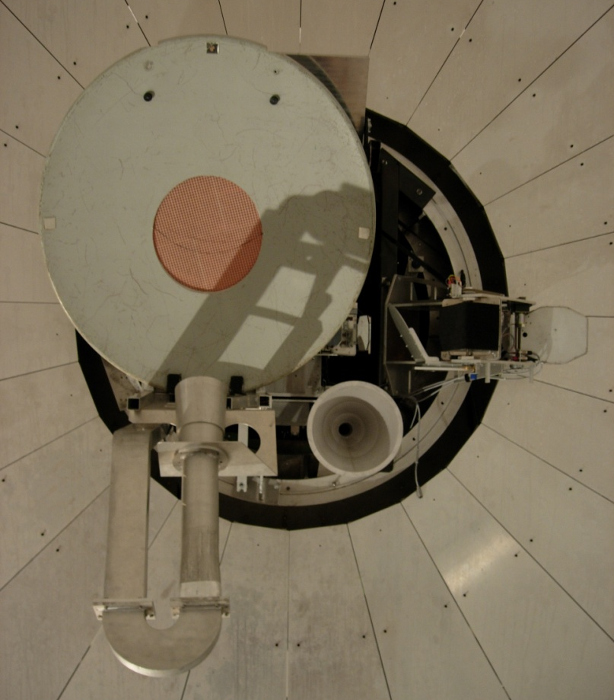
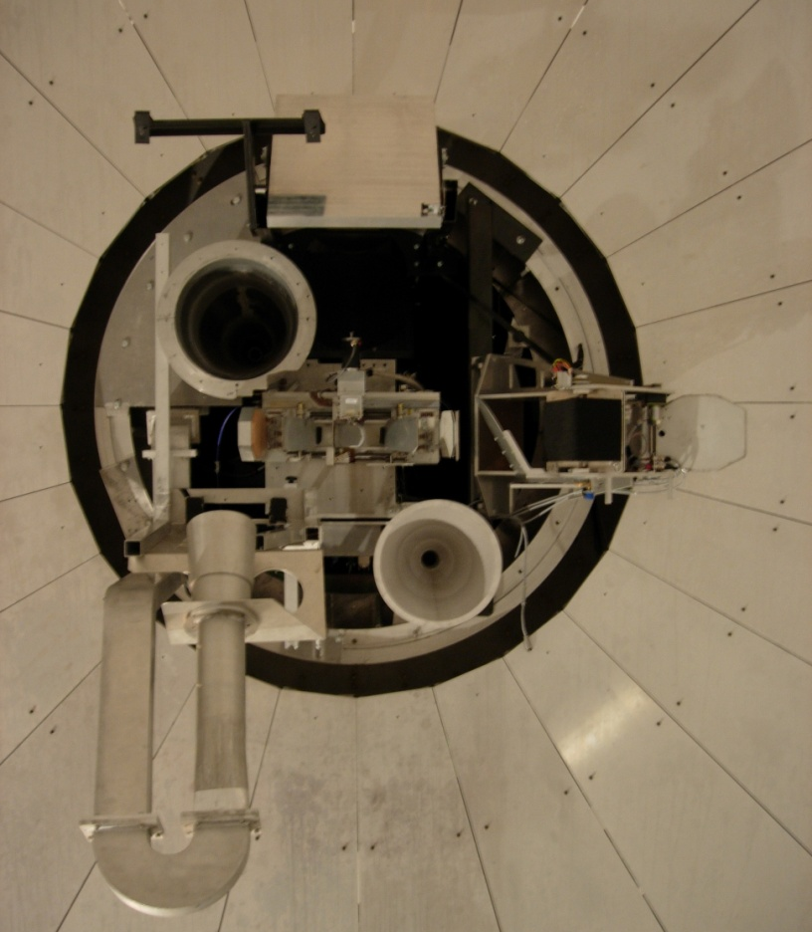
Focal plane of the 20m
S-band tertiary
X-band horn
18 – 50 GHz folding mirror
X-band dichroic filter
18 – 50 GHz beam switch
68 – 116 GHz beam switch
C-band test horn
S-band horn

Slide 11
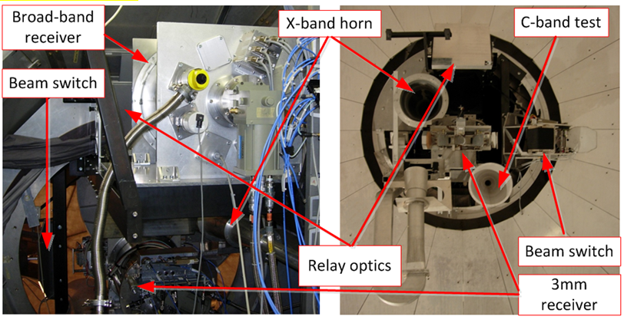
Current layout
68 – 116 GHz beam switch
18 – 50 GHz
Relay optics
68 – 116 GHz receiver

Slide 12
S/C/X band feeds and front-end

Slide 13
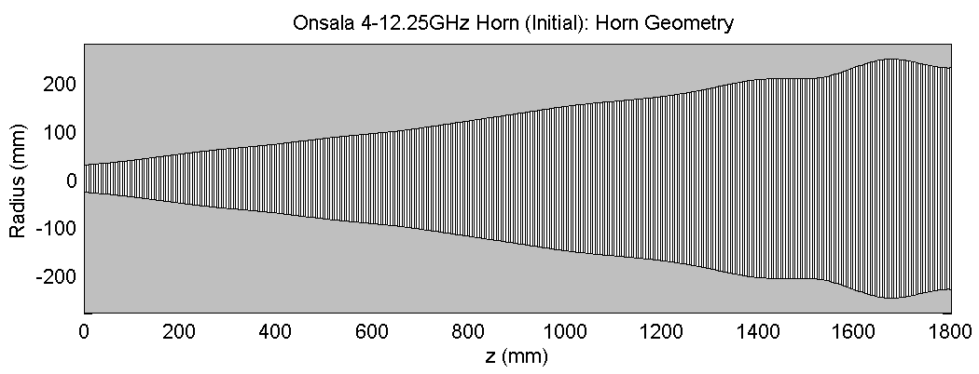
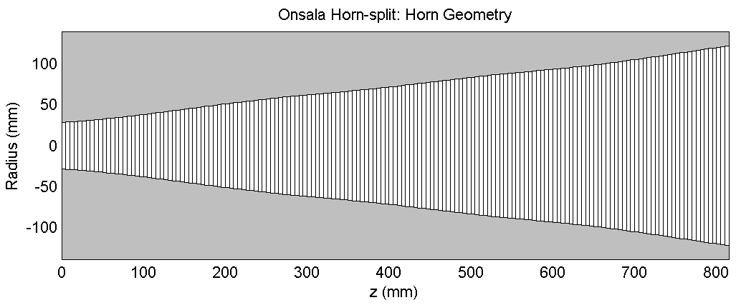
4 – 12.25 GHz Horn for OSO 20 m
Full-Size Horn
Horn “split” at 816mm for geoVLBI (VGOS) operations
Dr Christophe Granet - Lyrebird Antenna Research Pty Ltd
Dr John S. Kot - Lyrebird Antenna Research Pty Ltd

Slide 14
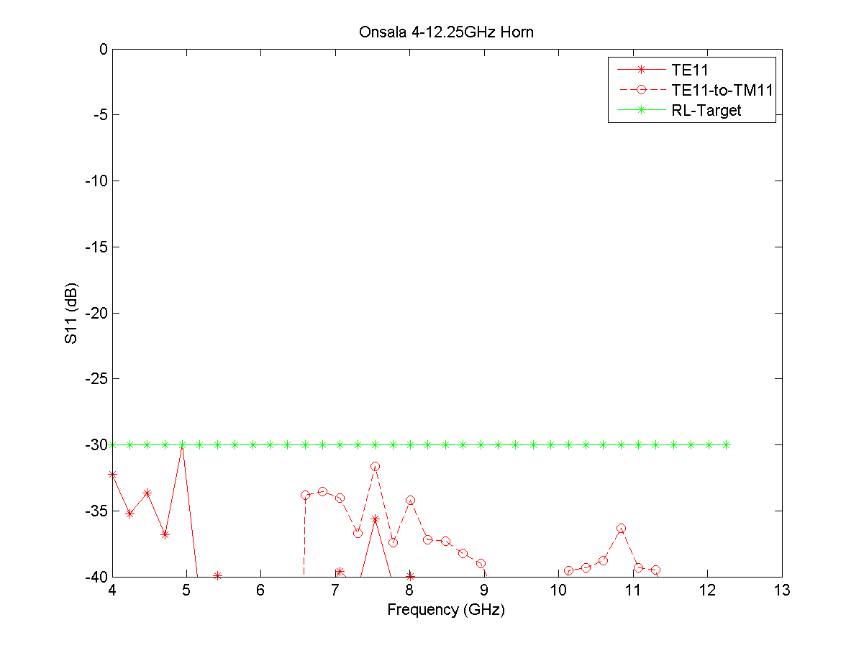
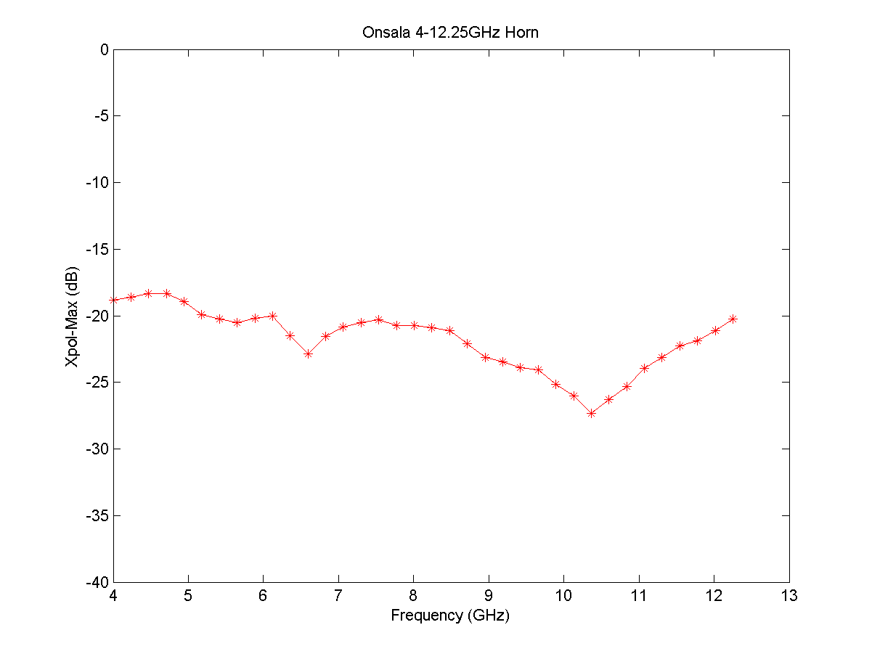
Design of the 4 – 12.25 GHz
Dr Christophe Granet - Lyrebird Antenna Research Pty Ltd
Dr John S. Kot - Lyrebird Antenna Research Pty Ltd

Slide 15
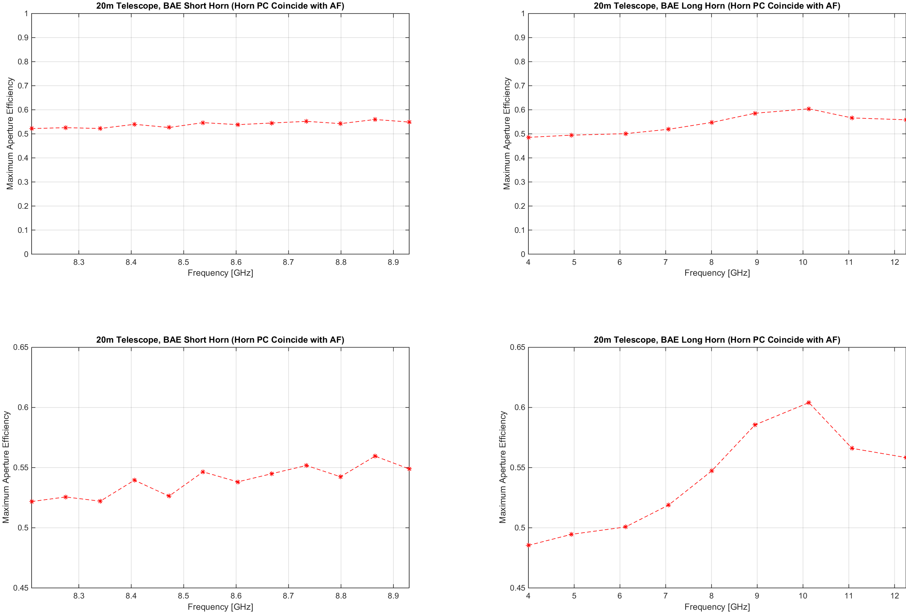
Feed - Reflector system simulations preliminary results
Dr Christophe Granet - Lyrebird Antenna Research Pty Ltd
Dr John S. Kot - Lyrebird Antenna Research Pty Ltd

Slide 16
The Offset Probe OMT Design
Rear Transition from double ridged waveguide to coax
Polarisation separating junction
Transition from circular to quad ridged waveguide
Dr Mark Bowen - CSIRO Astronomy and Space Science
Alex Dunnin - CSIRO Astronomy and Space Science
Notes:
The offset probe OMT
To avoid the problems associated with the co-located probe design we have separated the probes in a offset probe design.
The image in the top right corner is of a narrowband offset probe OMT. These OMTs have been developed in the past however they have not been shown to exhibit the same frequency coverage as the co-located probe designs
The OMT considered here was designed in three separate sections, an input transition from circular to quad ridged waveguide, a ortho-mode junction which removes the A polarisation via a coaxial probe and a rear transition from double ridged waveguide to coax.
Because of the nature of quad ridged waveguide only in the input transition must multiple propagating mode be considered.

Slide 17
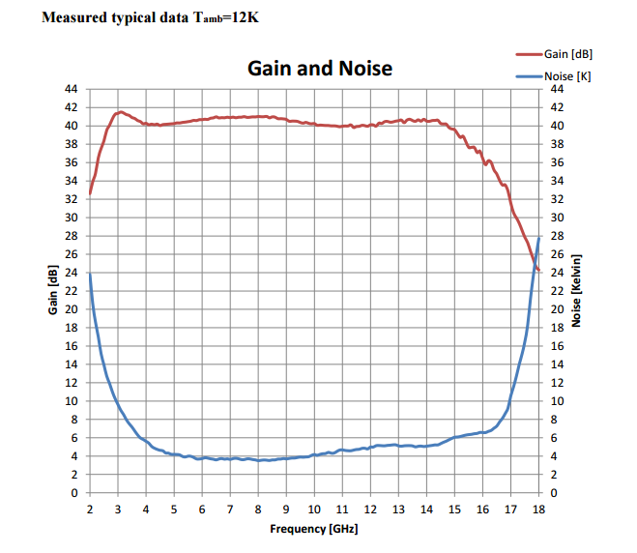
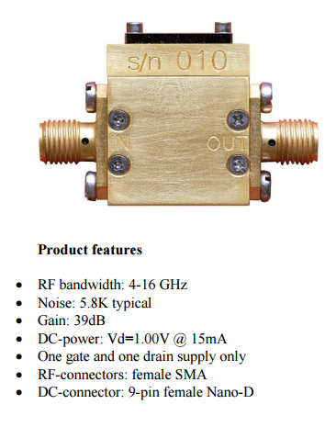
LNA from Low Noise Factory
Notes:
The offset probe OMT
To avoid the problems associated with the co-located probe design we have separated the probes in a offset probe design.
The image in the top right corner is of a narrowband offset probe OMT. These OMTs have been developed in the past however they have not been shown to exhibit the same frequency coverage as the co-located probe designs
The OMT considered here was designed in three separate sections, an input transition from circular to quad ridged waveguide, a ortho-mode junction which removes the A polarisation via a coaxial probe and a rear transition from double ridged waveguide to coax.
Because of the nature of quad ridged waveguide only in the input transition must multiple propagating mode be considered.

Slide 18
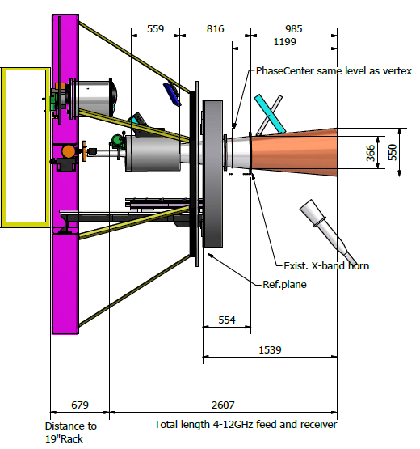
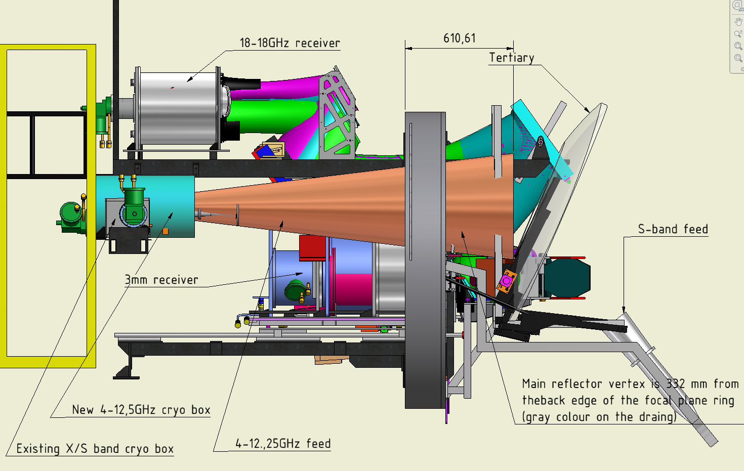
Feed-receiver integration – side view

Slide 19
Pre-study for upgrade of the
OSO 20m for K/Q/W band competability

Slide 20
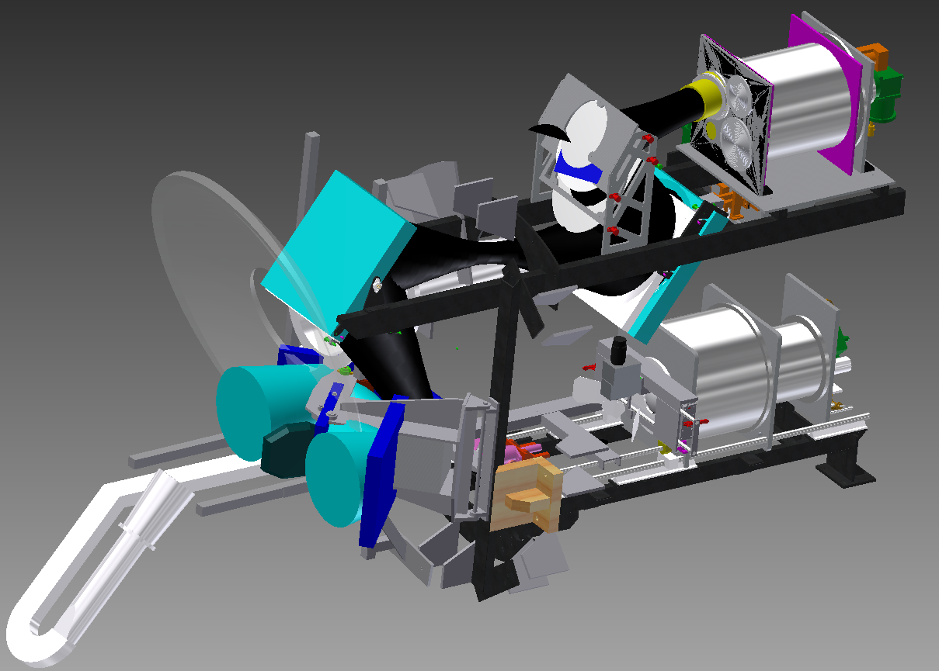
Design altenatives
Triple band layout with dichroic filters – not applicable due to volume envelope
Dual Band with dichroic filters
Dual band layout: wide band feed and single band feed with dichroic filter
Triple band feed

Slide 21
Dual band with dichroic filter and existing receivers
Dichroic
22 or 43 GHz beam
86 GHz beam
Relay optics for 86 GHz

Slide 22
Wide-Band Feeds (22/43 GHz or 43/86 GHz)
22/43 GHz Feed: 20-45 GHz (2.25:1 bandwidth) can be designed and the signal extracted through a suitably designed wide-band OMT.
43/86 GHz Feed: 41-88 GHz (2.15:1 bandwidth) can be designed and the signal extracted through a suitably designed wide-band OMT
Pros: Using a single-band feed and a dual-band feed would reduce the number of receivers needed and extra dichroic/reflector required.
Cons: Still issues with loss, space and complexity of design of the extra dichroic/reflector required.

Slide 23
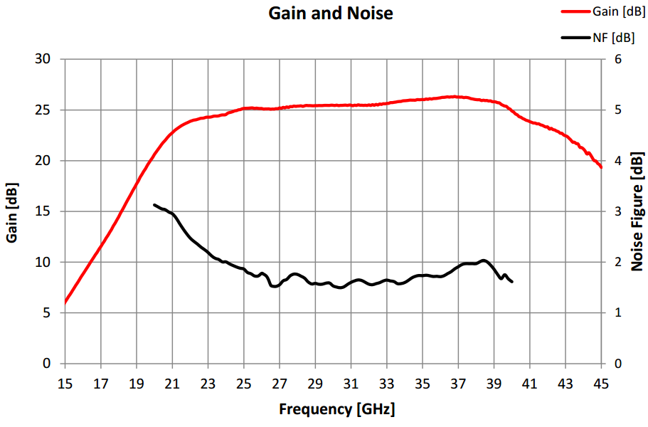
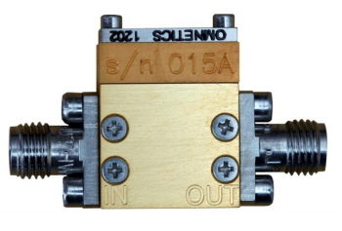
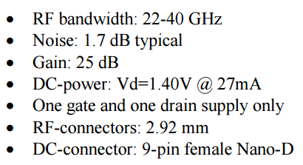
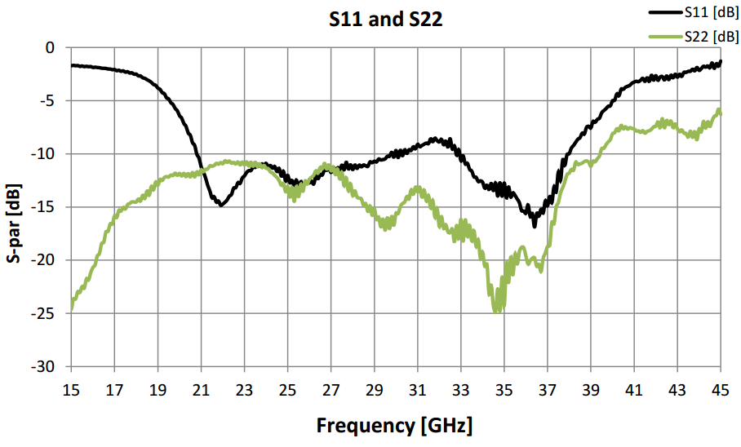
LNAs available from LNF – coaxial RT

Slide 24
Can we design feed working simultaneously at 22 GHz, 43 GHz and 86 GHz?
Pre-study project with Lyrebird Antenna Research
Can a 4 GHz bandwidth be used around these centre frequencies?
22 GHz Band: 20 - 24 GHz
43 GHz Band: 41 - 45 GHz
86 GHz Band: 84 - 88 GHz
Can the feed be tailored to fit various antennas around the world with different F/D ratios, i.e., half subtended angle to the subreflector varying from 6 deg to 27 deg?
Dr Christophe Granet - Lyrebird Antenna Research Pty Ltd
Dr John S. Kot - Lyrebird Antenna Research Pty Ltd

Slide 25
Tri-Band Feed
If it was possible to design a single tri-band feed system with the required performance on the different reflector systems, there would be significant advantages in using such a system
Pros:
  A relatively simple, compact feed system without the need for dichroics or auxiliary reflectors.
  Simplify the design of the dewar / cryogenic system.
  Avoid optics alignment problems
  Cons:
  The performance of the feed itself is uncertain at this stage.
  While the performance of a tri-band feed horn itself would be a compromise compared to single-band feeds, its performance compared to a complete system of feeds, dichroics, and auxiliary reflectors may be comparable or even better.
Dr Christophe Granet - Lyrebird Antenna Research Pty Ltd
Dr John S. Kot - Lyrebird Antenna Research Pty Ltd

Slide 26
Preliminary Tri-Band Findings
Lyrebird Antenna Research has carried out a very preliminary study on possible feed geometries that could handle the 4 GHz bandwidth requirements around 22, 43 and 86 GHz.
A number of ideas were looked at based around the coaxial horn geometry.
The most promising results to date come from the idea of using a dielectrically-loaded coaxial horn where the loaded circular waveguide carries the 86 GHz band and the coaxial waveguide carries both the 22 GHz and 43 GHz bands.
The following results are preliminary, but they show that it may be possible, with more research and optimization to arrive at a suitable solution. Some funding to do a more in-depth feasibility study would however be required, especially if a prototype is needed to validate the research.
Dr Christophe Granet - Lyrebird Antenna Research Pty Ltd
Dr John S. Kot - Lyrebird Antenna Research Pty Ltd

Slide 27
Preliminary Design Goals
The following design goals were used in this tri-band preliminary design:
- 22 GHz Band (4 GHz Bandwidth): 20 - 24 GHz.
- 43 GHz Band (4 GHz Bandwidth): 41 - 45 GHz.
- 86 GHz Band (4 GHz Bandwidth): 84 - 88 GHz.
- Return loss of 18 dB as a minimum target in all bands.
- Nominal Gaussian radiation pattern goal with a -12dB taper at 20deg at 22 GHz and 86 GHz and -15dB at 43 GHz.
- Maximum level of cross-polar goal within +/-20deg of -20 dB
- The feed is assumed to be fed by an ideal TE₁₁ mode for now in each band. We have not designed, as yet, the signal extraction part, but we have experience in this and think it is feasible.
- The approach can be customized to fit various reflector geometries (F/D ratios)
Dr Christophe Granet - Lyrebird Antenna Research Pty Ltd
Dr John S. Kot - Lyrebird Antenna Research Pty Ltd

Slide 28
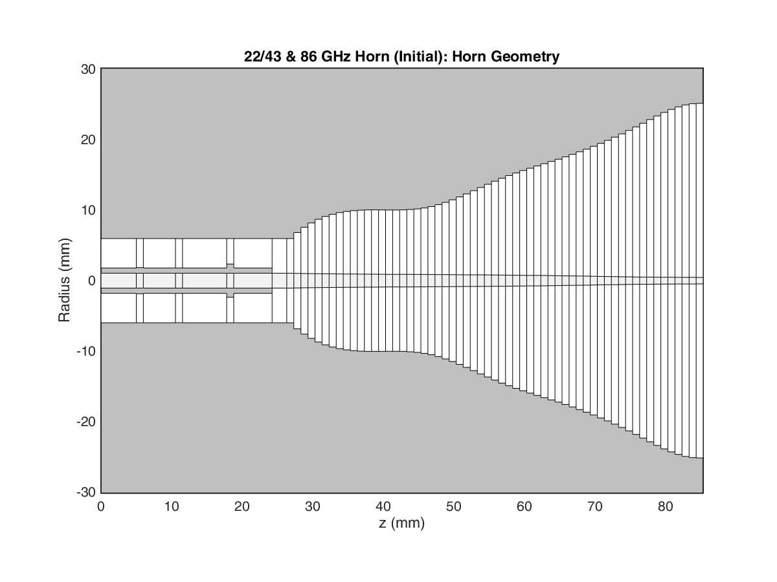
Preliminary Design Geometry
Dr Christophe Granet - Lyrebird Antenna Research Pty Ltd
Dr John S. Kot - Lyrebird Antenna Research Pty Ltd

Slide 29
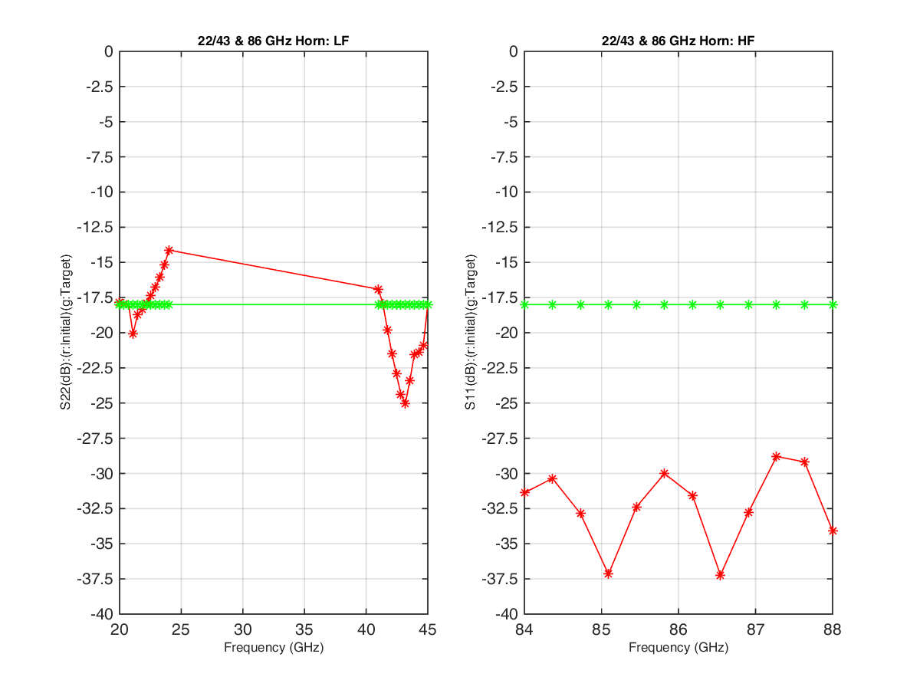
Return Loss of preliminary design
Dr Christophe Granet - Lyrebird Antenna Research Pty Ltd
Dr John S. Kot - Lyrebird Antenna Research Pty Ltd

Slide 30
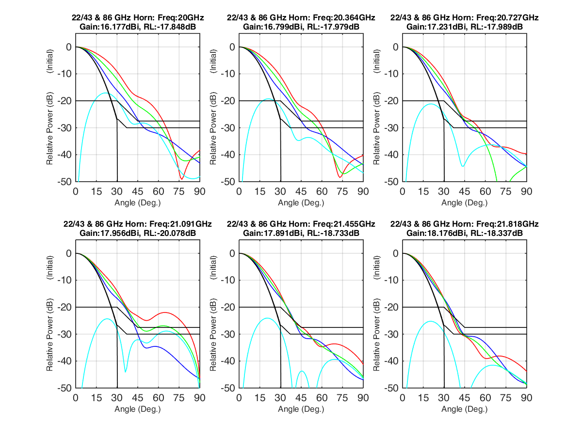
Theoretical Pattern (Preliminary): 22 GHz (1 of 2)
Dr Christophe Granet - Lyrebird Antenna Research Pty Ltd
Dr John S. Kot - Lyrebird Antenna Research Pty Ltd

Slide 31
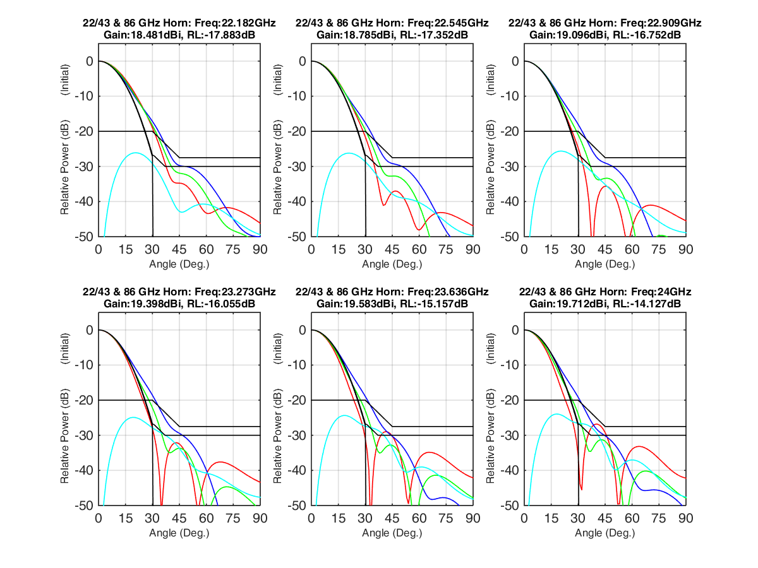
Theoretical Pattern (Preliminary): 22 GHz (2 of 2)
Dr Christophe Granet - Lyrebird Antenna Research Pty Ltd
Dr John S. Kot - Lyrebird Antenna Research Pty Ltd

Slide 32
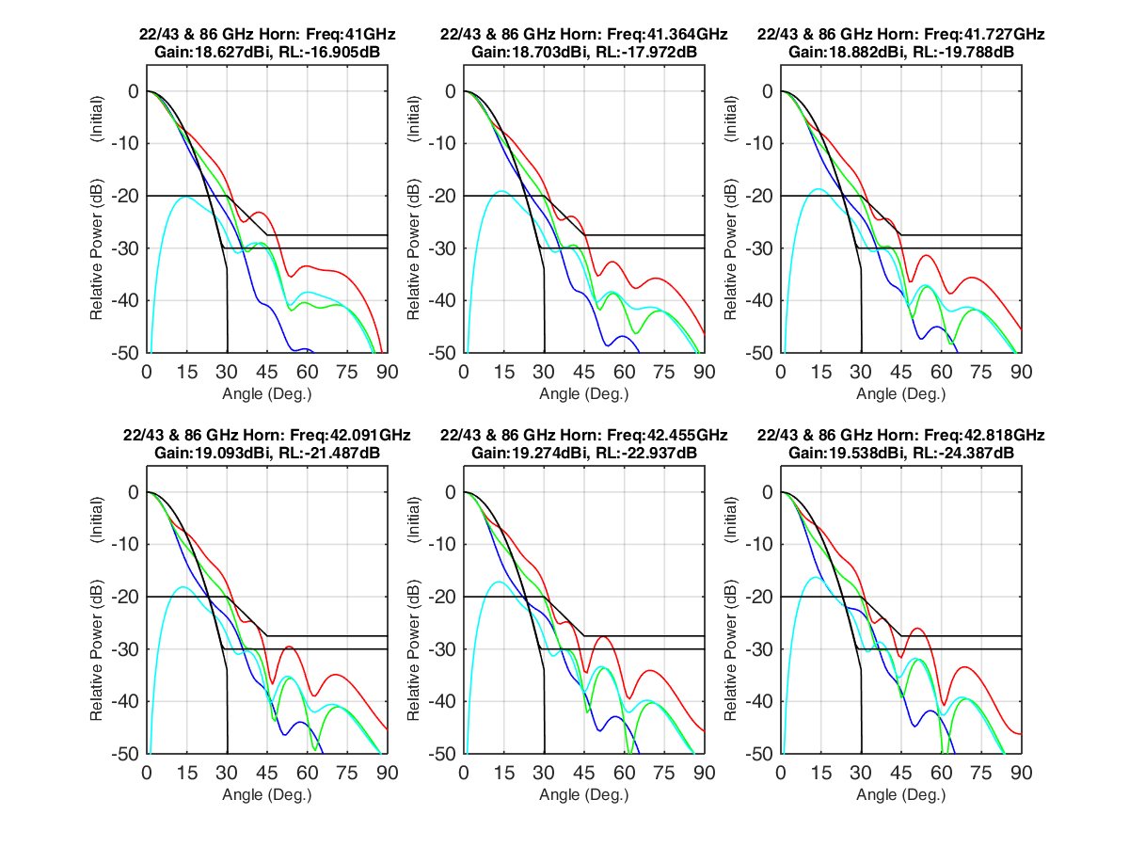
Theoretical Pattern (Preliminary): 43 GHz (1 of 2)
Dr Christophe Granet - Lyrebird Antenna Research Pty Ltd
Dr John S. Kot - Lyrebird Antenna Research Pty Ltd

Slide 33
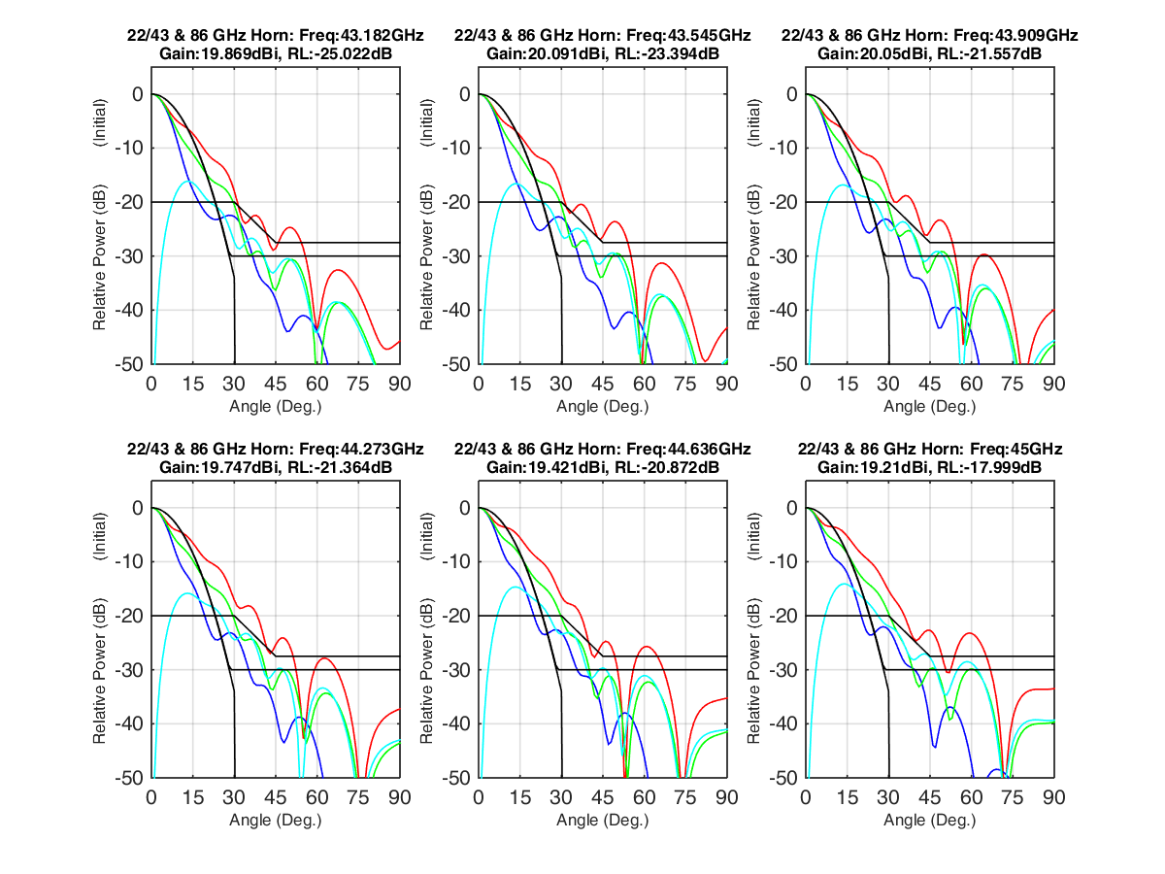
Theoretical Pattern (Preliminary): 43 GHz (2 of 2)
Dr Christophe Granet - Lyrebird Antenna Research Pty Ltd
Dr John S. Kot - Lyrebird Antenna Research Pty Ltd

Slide 34
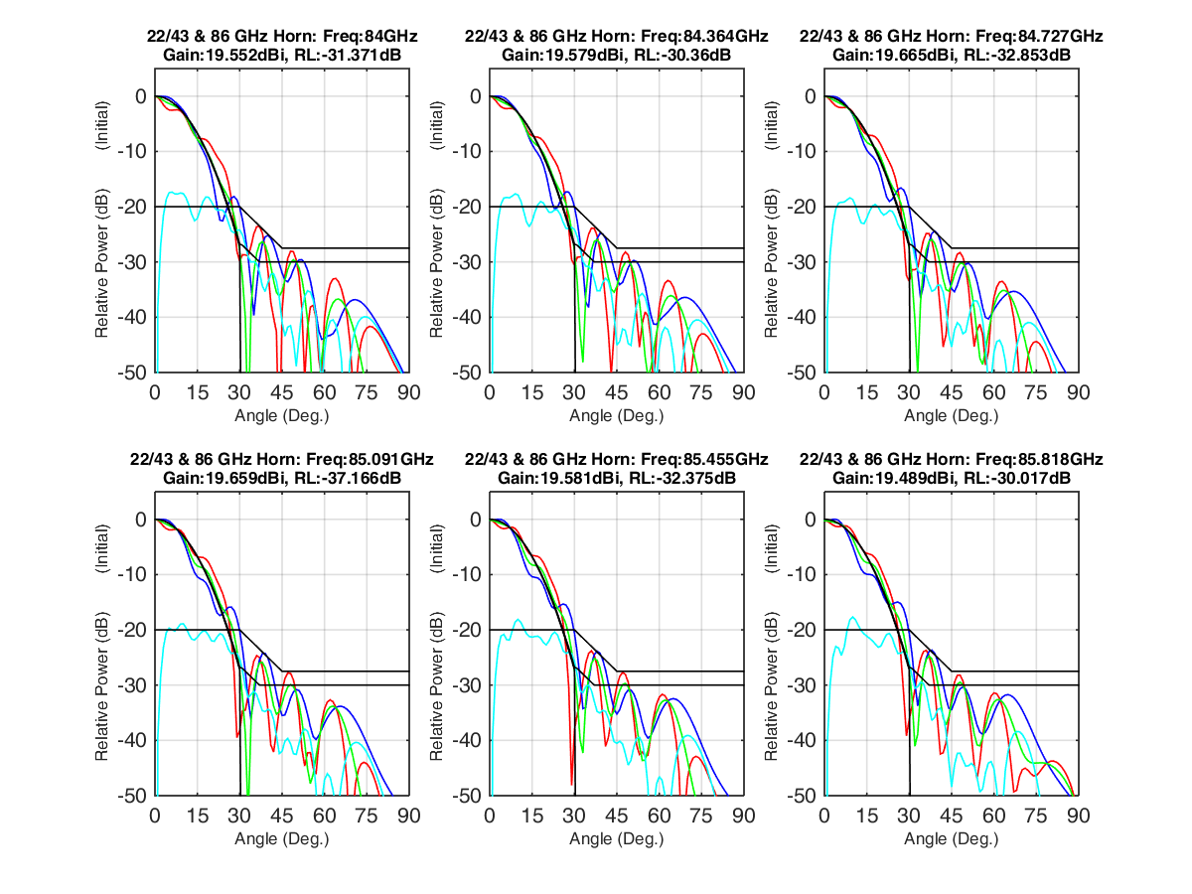
Theoretical Pattern (Preliminary): 86 GHz (1 of 2)
Dr Christophe Granet - Lyrebird Antenna Research Pty Ltd
Dr John S. Kot - Lyrebird Antenna Research Pty Ltd

Slide 35
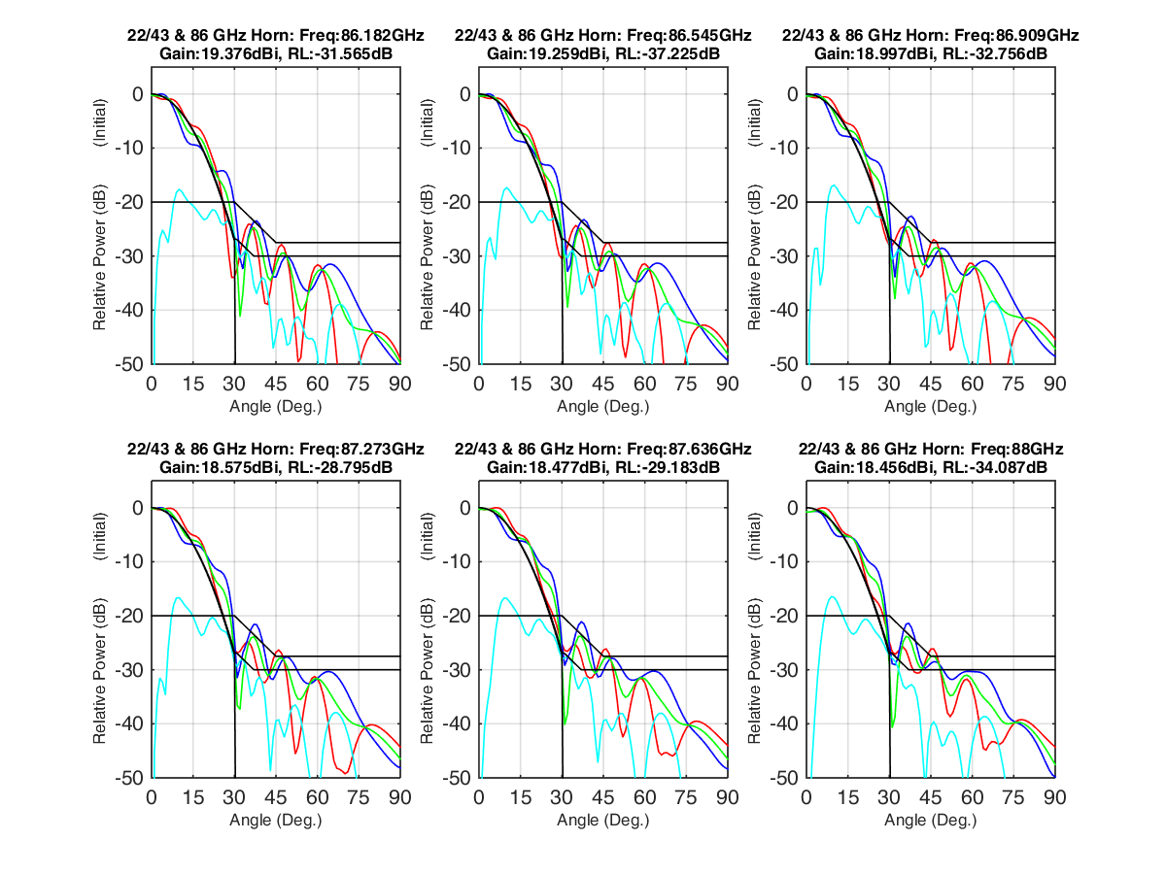
Theoretical Pattern (Preliminary): 86 GHz (2 of 2)
Dr Christophe Granet - Lyrebird Antenna Research Pty Ltd
Dr John S. Kot - Lyrebird Antenna Research Pty Ltd

Slide 36
Summary
Detailed design and purchase of key components of 4-12GHz front-end for OSO 20m is ongoing
22/86 GHz or 43/86 GHz system at OSO can be available within 6 to 12 months if approved from our director
Preliminary K/K/W feed design shows good efficiency

Slide 37
How to handle an international activity on front-ends for multi band mm-VLBI
Form working group or Consortium for mm-multy band VLBO
Write science cases
Write high level technical specification
Write MoU
Set-up clear IP rules and NDA
Write flexible PBS that allow to build flexible system satysifying all optics and volume cases
Ask partners to sign for in-kind contribution to deliver initial design study for various components
Involve industry in the initial design – LNF, Omnisys, Lyrebird Antennas
Involve other universities – NUIM, Irland

Slide 38
Questions?

